Slide 1
Meeting with Rothbart Lab
2023-07-24

Slide 2
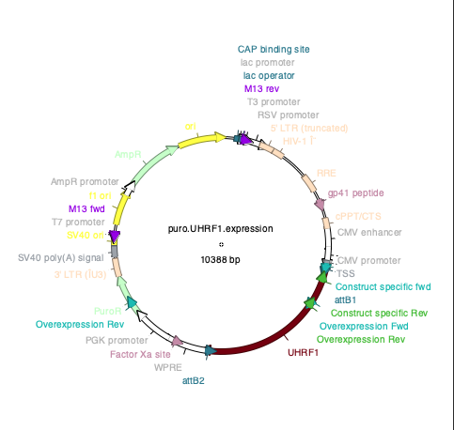
UHRF1 OVX cell model
primary fetal fibroblasts (AG06561)
caucasian 15FW, XX from minced skin
https://catalog.coriell.org/0/Sections/Search/Sample_Detail.aspx?Ref=AG06561&Product=CC
primary adult fibroblasts (AG07471)
caucasian 32yrs, XX from arm skin
https://www.cellosaurus.org/CVCL_2C31

Slide 3
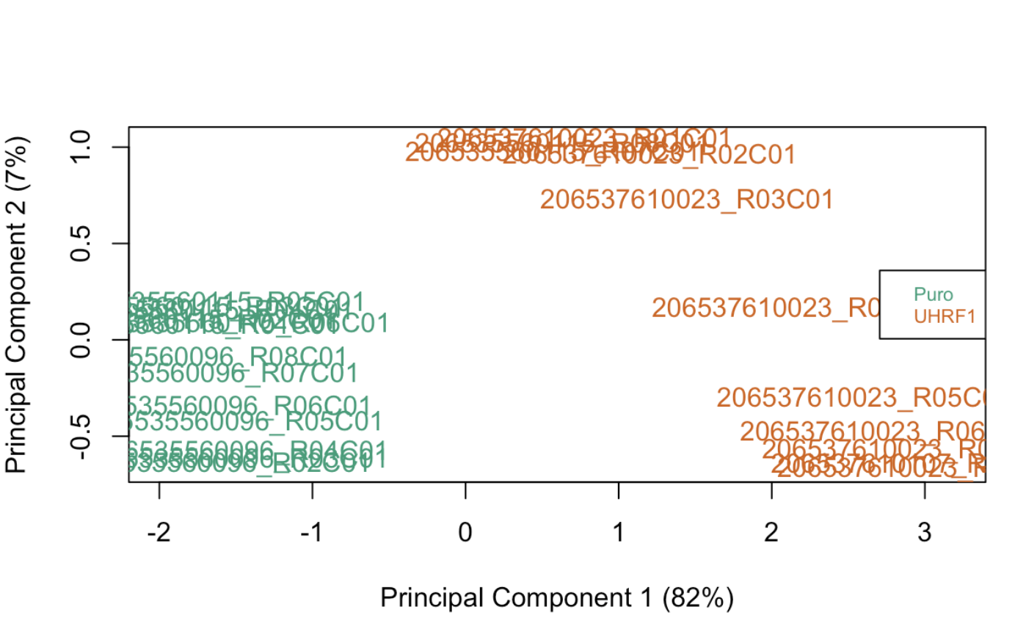
QC: PCA plot of UHRF1_overexpression EPIC
Using 1000 common gene annotations to calculate PCA
no outliers detected.

Slide 4
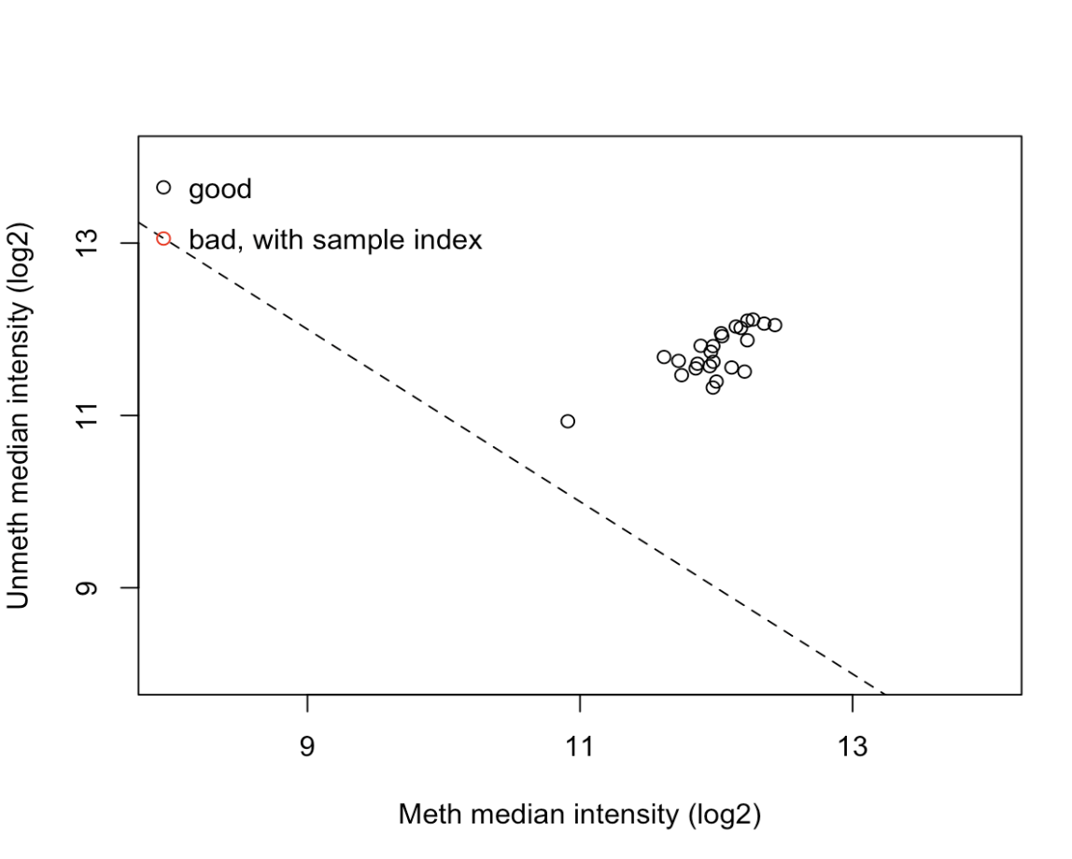
QC plot
RgSet -> ratio clustering
Most samples are clustered together, with 1 exception that is beneath threshold

Slide 5
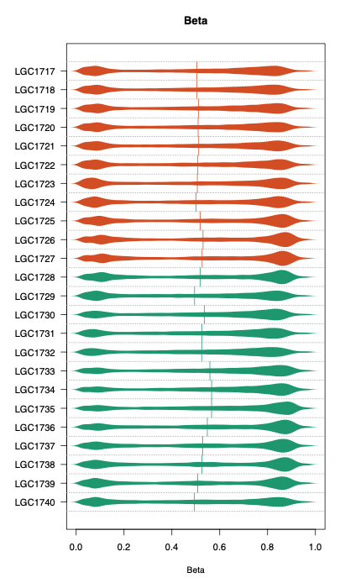
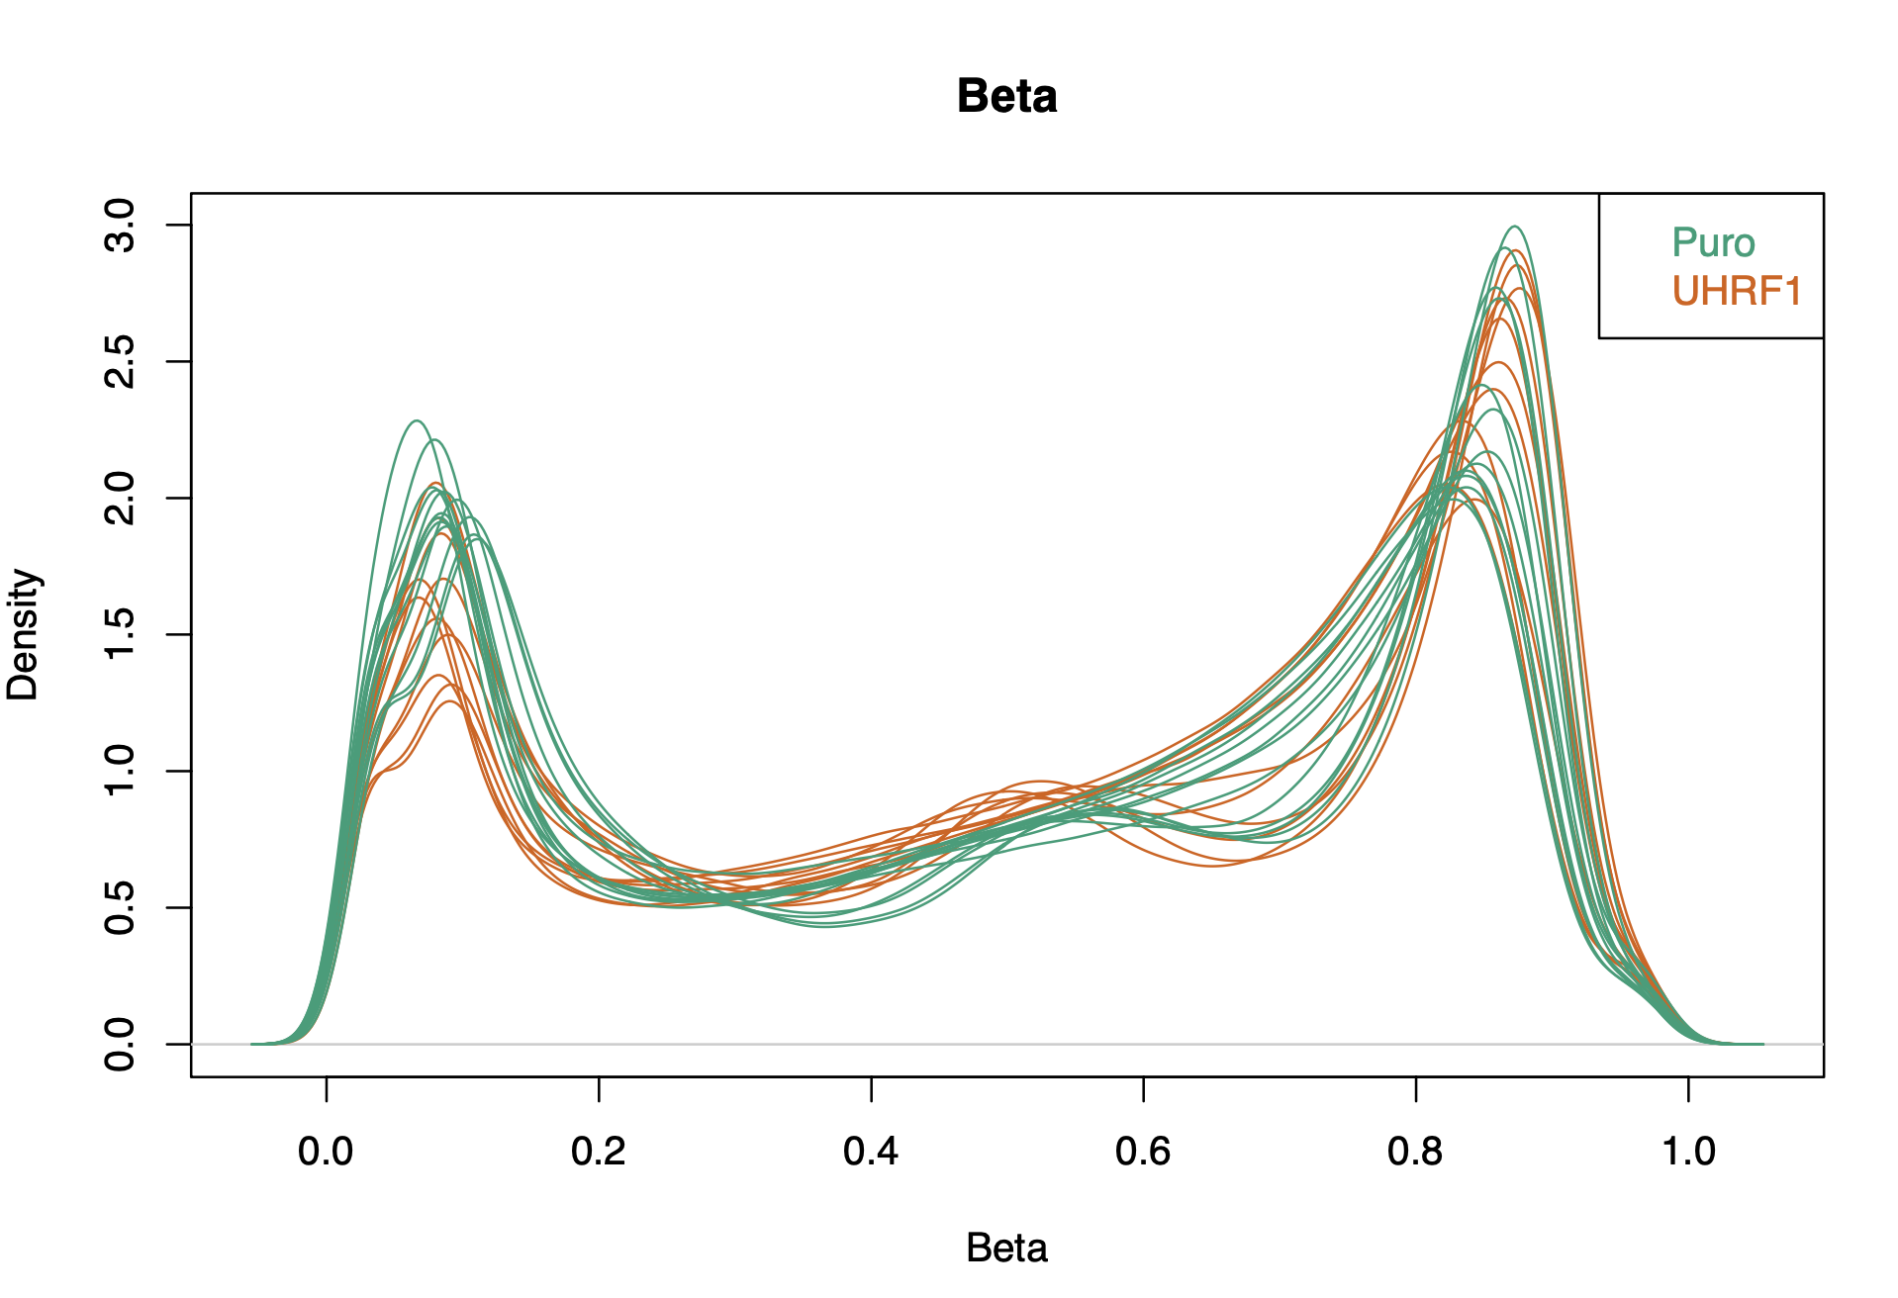
QC : Density Plots of UHRF1_overexpression
all pass QC, no filtering necessary

Slide 6
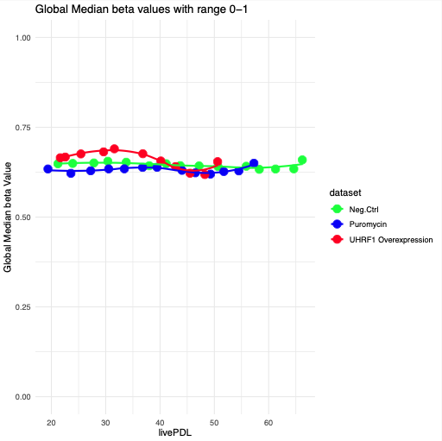
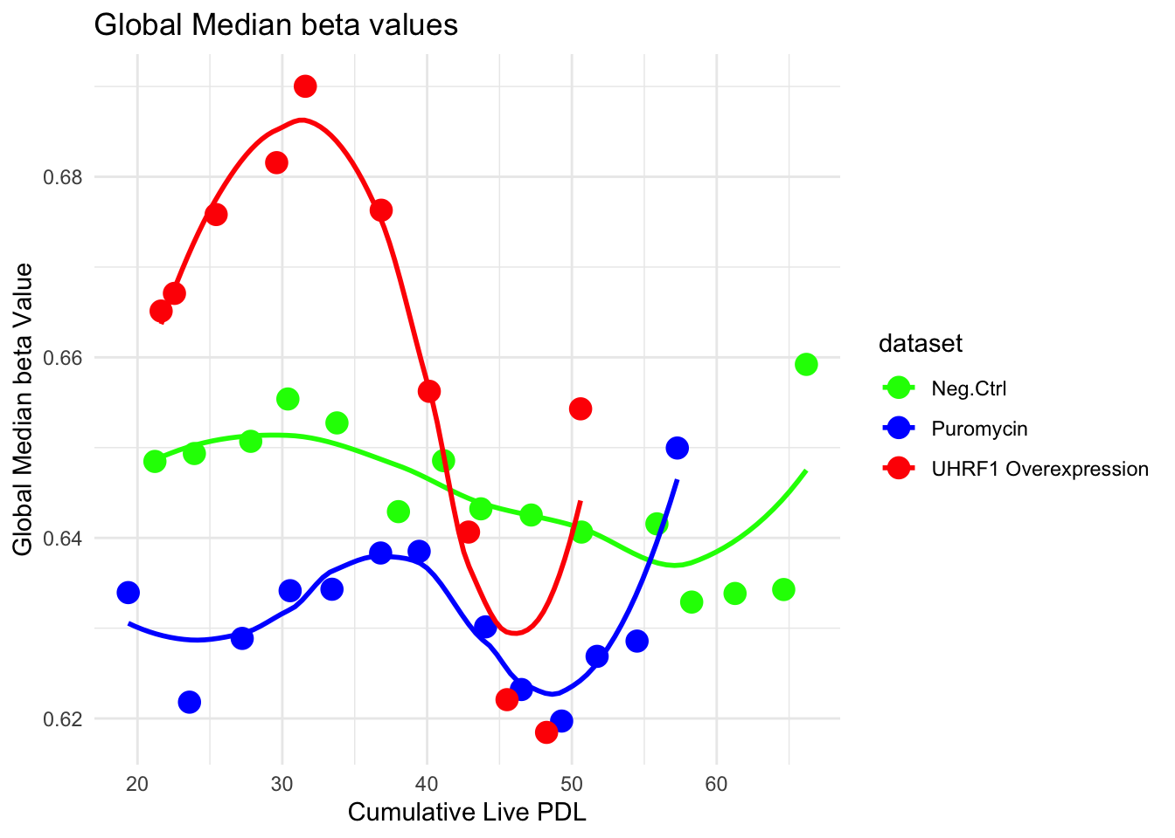
UHRF1_OVX has global hypermethylation than the puromycin control

Slide 7
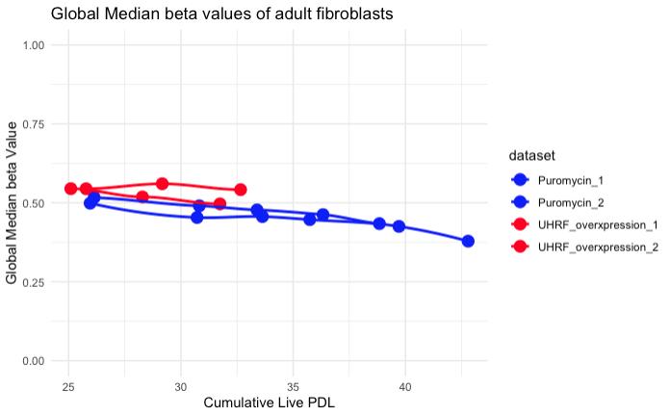
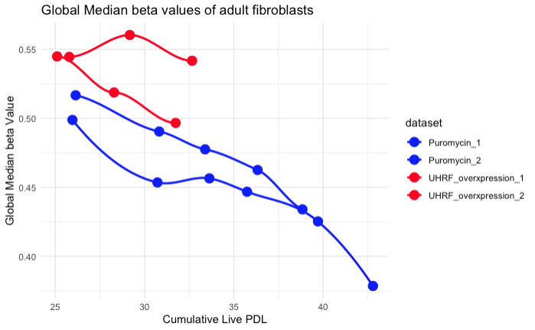
Adult fibroblasts also show global hypermethylation
zoomed in.
however UHRF1_OVX in adult fibroblasts did not passage for long

Slide 8
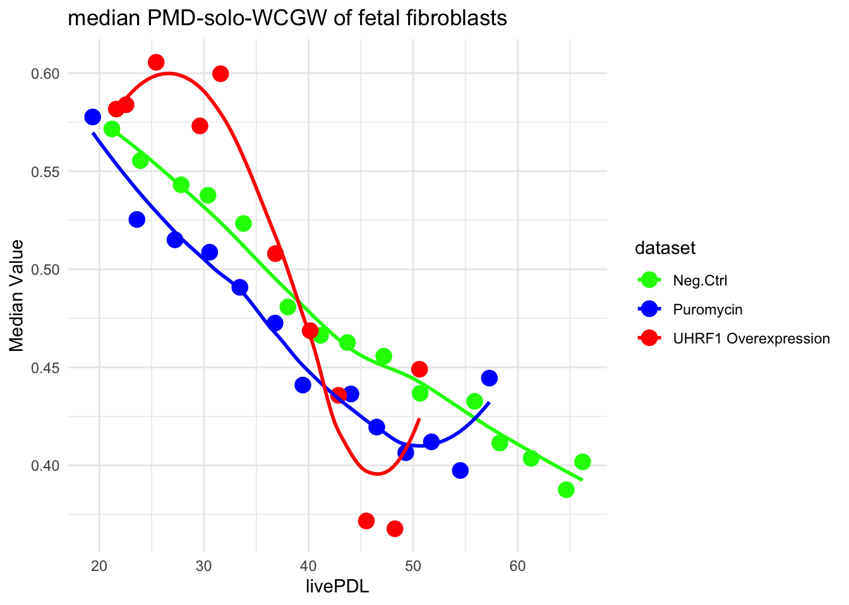
In Early PDL, UHRF—OVX fetal fibroblasts have higher median PMD-solo-WCGW

Slide 9
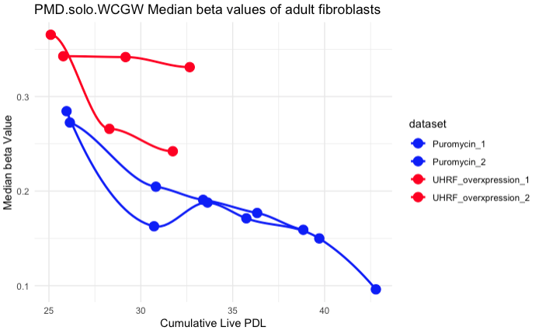
adult fibroblasts also show higher PMD-solo-WCGW

Slide 10
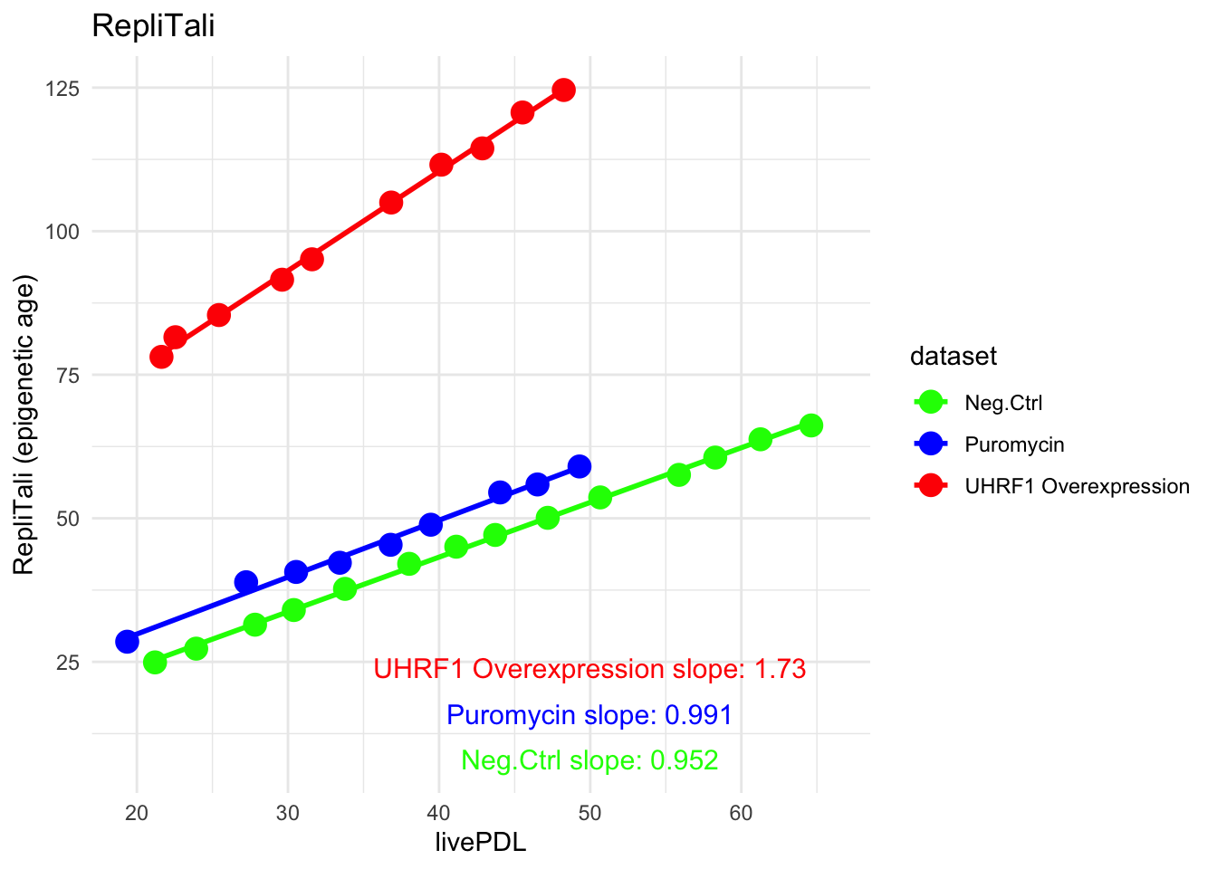
UHRF_OVX shows higher Replitali slope; (accelerated Epigenetic age phenotype)

Slide 11
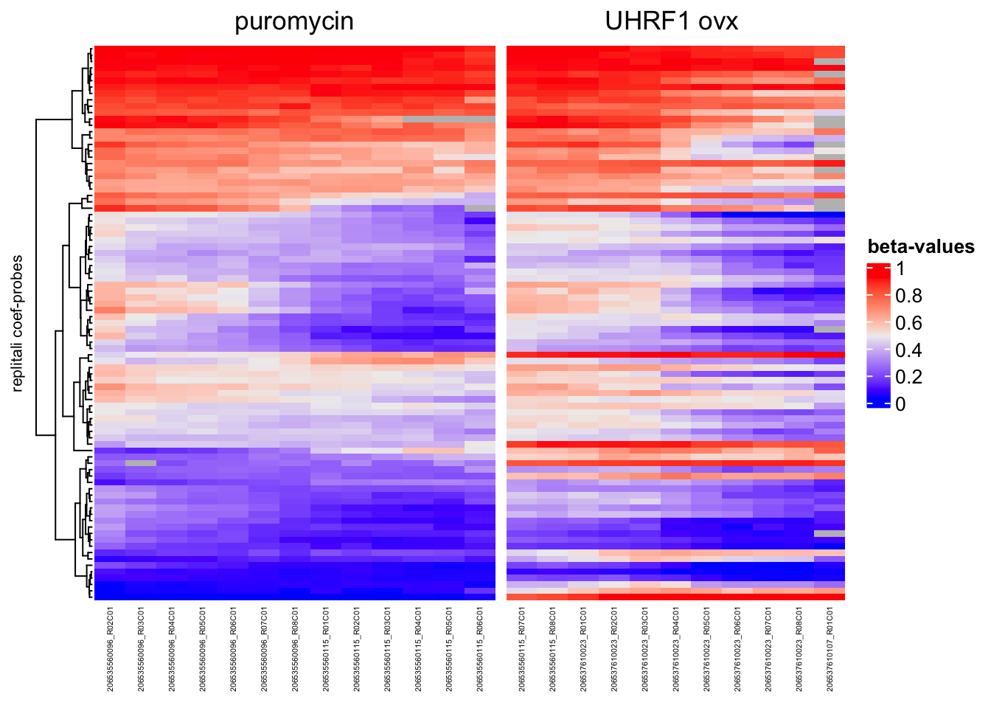
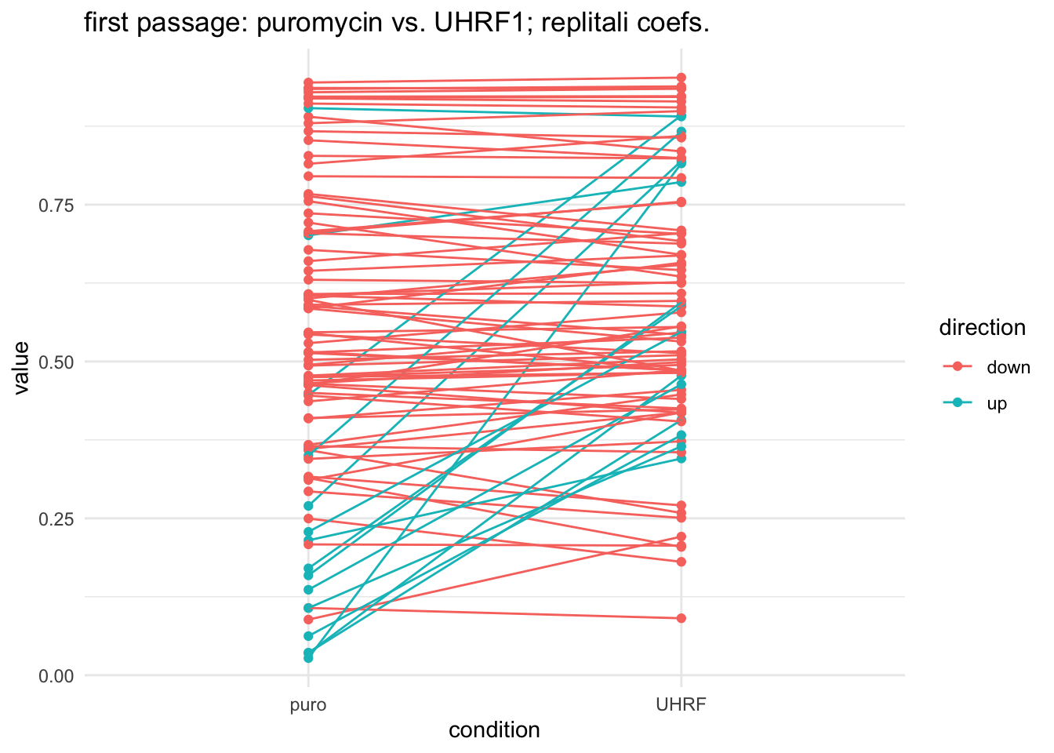
Why is the Y-intercept for UHRF1 so high?
Do these probes have higher sensitivity to UHRF–OVX?

Slide 12
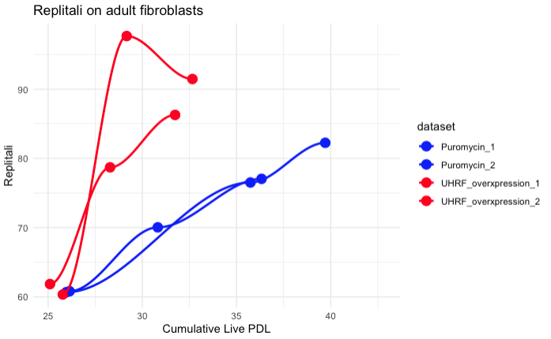
Adult fibroblasts also show a higher slope
caveat. (1 probe from the UHRF_OVX dataset had NA, so calculated Replitali without it.

